Slide 1
Queries
February 27, 2014

Slide 2
Lesson objectives
By the end of this lesson, you should be able to:
Use Gosu queries to retrieve sets of objects from the database that cannot be accessed through an existing array
This lesson uses the notes section for additional explanation and information. To view the notes in PowerPoint, choose View→Normal or View→Notes Page. If you choose to print the notes for the lesson, be sure to select "Print hidden slides."

Slide 3
Lesson outline
Gosu query basics
Working with queries
Working with result sets

Slide 4
Gosu queries
A Gosu query is an object associated with a specific entity that stores a database query and its results
Gosu queries are useful when code must work with a set of objects that does not exist as an array, such as "all contact notes created by this user"
Notes:
Gosu also supports find expressions, which can also query databases. Guidewire recommends that all new queries be written as Gosu queries, however, because Gosu queries have the following advantages:
They more readily support the construction of complex queries.
They use builder patterns, which simplify the creation of search screens.
They use a syntax more intuitive to people accustomed to writing queries in Structured Query Language (SQL).

Slide 5
Objects used when querying database
table condition 1 condition 2
table
Coverage
query object
results object
Query object stores criteria of query, such as:
Which entity to query
What restrictions (where clauses) to apply
Results object stores results and related info:
How many results?
If necessary, how should they be ordered?

Slide 6
Steps to execute a basic query
Create the query object using the make() method
Create the results object using the select() method
Process the results of the query as needed

Slide 7
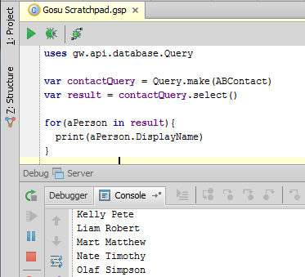
Step 1: Create the query object
Syntax: var queryObj = gw.api.database.Query.make(EntityToQuery)
Notes:
The make method is a method of the Query class. This class is declared in the gw.api.database package. A package is a collection of classes grouped together for convenience or because fields or methods in those classes should have access to one another while instances of classes outside of the package should not, or both.

Slide 8
Step 2: Create the results object
Syntax: var resultsObj = queryObj.select()
Notes:
You do not always need to create an explicit results object. The code shown in the screenshot above produces the same results if written like this:
var policyPersonQuery = gw.api.database.Query.make(ABPolicyPerson)
for (aPolicyPerson in policyPersonQuery.select()) {
print (i + ": " + aPolicyPerson.DisplayName)
}
The examples in this lesson typically show an explicit result set object being created to make the code in the examples more readable and to make it clear which object has the method in question.

Slide 9
Step 3: Process results of query as needed
You can use a for loop to iterate through the result set as if it were an array
Notes:
Line 4 in the code above prints the display name of the current policy person. In production code, this would typically be achieved by writing "print (aPolicyPerson)". References to an object inherently return the object's display name. The ".DisplayName" is included in the code above solely to make the code more readable for instructional purposes.
Recall that the for loop can have an optional index variable that can be used to display the number of each result. For example, the following code...
for (aPolicyPerson in resultSet index i) {
print (i + ": " + aPolicyPerson.DisplayName)
}
…produces the following output...
1: Alex Newton
2: Bert Simpson
3: Charles Simpson

Slide 10
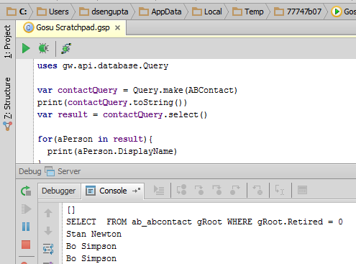
Viewing approximation of SQL query
Syntax: queryObj.toString()
Actual SQL may vary based on the RDBMS
Notes:
The query object's toString method provides an approximation of the SQL sent to the database to execute the query. These results are an approximation because the actual SQL may have vendor-dependent variations or vendor-dependent optimizations or both. A given query may have slight syntactic variations depending on whether it is used for an Oracle database or a SQL Server database.
You can record the exact SQL query in the logs using the withLogSQL method on a query. The method takes a single boolean argument that, when set to true, logs the query in the system logs in the logging category Server.Database.

Slide 11
Lesson outline
Gosu query basics
Working with queries
Working with result sets

Slide 12
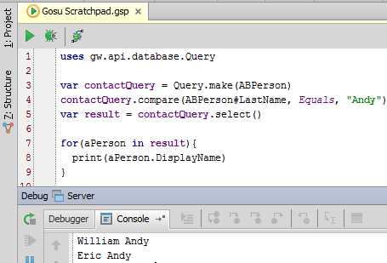
Restricting queries
Query objects have methods that add restrictions to query
Typically, they become SQL where clause

Slide 13
Restricting queries: compare method
Syntax: queryObj.compare("field", operator, value)
Field and value must be strings
Valid operators include:
Equals
NotEquals
LessThan
LessThanOrEquals
GreaterThan
GreaterThanOrEquals

Slide 14
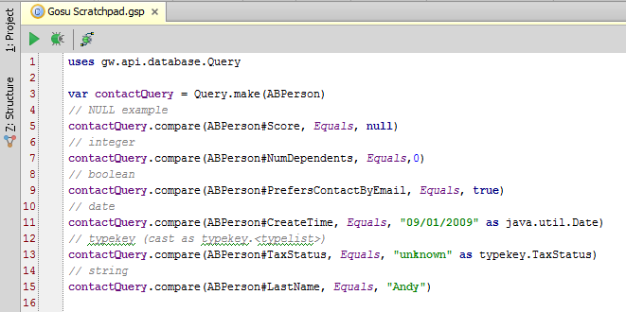
Specifying values in compare method
For strings, use quotes
For datetime and typekey, use quotes and cast object
Notes:
When using the compare method with a date value, you must cast the value as a date value. Otherwise, Guidewire treats the value as a string and it throws a type mismatch exception. To cast a value as a date value, use the syntax: "<datevalue>" as java.util.Date.
When using the compare method with a typekey value, you must cast the value as a typecode from the appropriate typelist. Otherwise, Guidewire treats the value as a string and it throws a type mismatch exception. To cast a value as a typecode from the appropriate typelist, use the syntax: "<typecode>" as typekey.<typelist>.

Slide 15
Null values for query restrictions
1 uses gw.api.database.Query
2 uses gw.api.database.Relop
3 var queryNull= Query.make(ABContact)
4 var queryNotNull= Query.make(ABContact)
5 // Contacts where Score IS NULL 6 queryNull.compare(ABContact#Score, Relop.Equals, null)
7 // Contact where Score IS NOT NULL
8 queryNotNull.compare(ABContactScore, Relop.NotEquals, null)
Entities can have elements that allow for null values
If there is no value, the database leaves the field as null
Restriction queries can compare for null or not null values
gw.api.database.Query | ANSI SQL
compare(entity.Property, Equals, null) | where table.columnName IS NULL
compare(entity.Property, NotEquals, null) | where table.columnName IS NOT NULL
Notes:
A null value signifies the absence of or void of a value.
In Guidewire applications, there are some data model entity elements that specify a nullok attribute. Column, foreignkey, onetoone, and typekey are elements that have the nullok attribute. When specified in the as an attribute of an element, you must define the nullok attribute (8.0.0).
Guidewire applications transform an entity element with a nullok=true attribute to a column definition in a physical database table. Relational databases create database tables using a form of Structure Query Language (SQL) known as Data Definition Language (DDL). With a nullok=false attribute, a Guidewire application executes a SQL / DDL statement to create a column constraint that specifies that the named column cannot contain a null value.

Slide 16
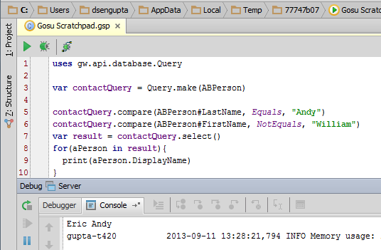
Multiple restrictions ANDed together
Query can have as many restrictions as needed
Restrictions are inherently ANDed together

Slide 17
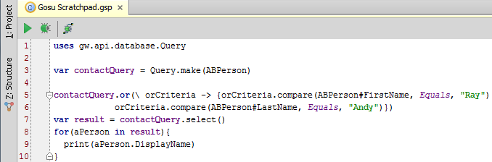
Multiple restrictions ORed together
The or() method requires a block that specifies criteria to "OR" together: queryObj.or( \ placeholder -> { placeholder.criteria placeholder.criteria // add as many criteria as needed })
Notes:
You can create a query that consists of multiple conditions that are ORed together. To do this, you must use the or() method. It takes a block as an input parameter. The block consists of a placeholder that represents the original query object. You can then list multiple criteria, all of which are ORed together. You can use any sort of criteria, including the comparison criteria discussed earlier in the lesson.
You can also combine conditions with AND and OR logic in complex ways. The following example finds all policy people whose first name is "John" or whose name is "Erica Hinds" (first name is Erica and last name is Hinds).
policyPersonQuery.or( \ orCriteria -> {
orCriteria.compare("FirstName", Equals, "John")
orCriteria.and( \ andCriteria -> {
andCriteria.compare("FirstName", Equals, "Erica")
andCriteria.compare("LastName", Equals, "Hinds")
})
})

Slide 18
Additional restriction options
Gosu Reference Guide contains complete list of all options for restricting queries, including restrictions that make use of:
between and Ranges
startsWith
contains

Slide 19
Lesson outline
Gosu query basics
Working with queries
Working with result sets

Slide 20
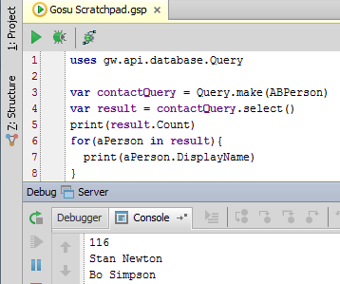
Getting size of results
Syntax: resultsObj.Count
Value will vary if number of rows in database that meet query's criteria changes
Notes:
The Count attribute identifies the number of objects in the result set. Developers should keep in mind that Guidewire does not query the database for the complete result set, however, and does not store a snapshot of the results of a given query. Therefore, the value of Count can vary if the number of rows in the database that meet the query's criteria changes while the query results are being processed. The field is introduced here as it is useful for instructional and debugging purposes, but it can be problematic if used in implementation code as an absolutely accurate reflection of the number of rows in the database that meet the query's criteria. For a further discussion of this topic, refer to the Gosu Reference Guide.

Slide 21
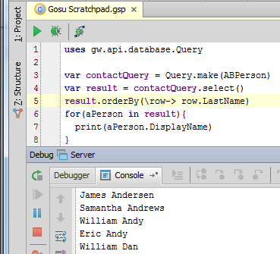
Sorting results
Each sorting methods takes a block as an argument
Syntax:
resultsObj.orderBy( \ row -> row.FieldName)
resultsObj.orderByDescending( \ row -> row.FieldName )
Notes:
The two methods listed above sort the entire result set according to the field name in either ascending (orderBy) or descending (orderByDescending) order. There are two other methods, as well: thenBy and thenByDescending. These methods do not re-sort the entire result set. Instead, they preserve any existing ordering and sort rows that tied during the first sort. For example, if you wanted to sort by last name and then by first name, you would use the following code:
resultSet.orderBy(\row -> row.LastName)
resultSet.thenBy(\row -> row.FirstName)

Slide 22
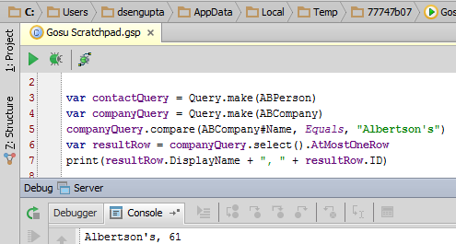
Querying when only one result is expected
Syntax: queryObj.select().AtMostOneRow
If single item exists, method returns that single row
If no item exists, method returns null
If multiple items exist, method throws exception

Slide 23
Lesson objectives review
You should now be able to:
Use Gosu queries to retrieve sets of objects from the database that cannot be accessed through an existing array

Slide 24
Review questions
For each of the following, identify the reason you would use it and whether it can be found on the query object or on the results object.
The select method
The compare method
The Count field
The orderby method
Notes:
Answers
1. a) This method produces the results of the query. It is on the query object.
b) This method creates a condition that restricts the results of the query. It is on the query object.
c) This field identifies the number of results in the query. It is on the results object.
d) This method sorts the results. It is on the results object.

